Slide 1
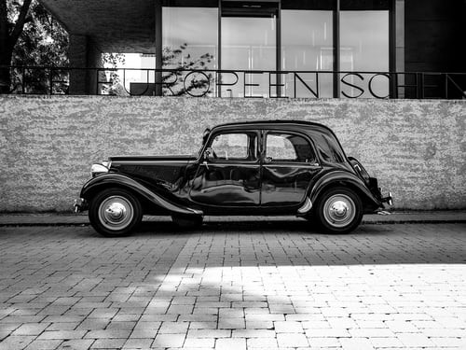
Used Car Price Predictions Prepared By Purva Sonsare
mirjam nilsson

Slide 2
agenda
Problem Statement
Problem Understanding
What is Used Car Price Predictions
Importance of Used Car Price Prediction
Exploratory Data Analysis
Visualizations
Model/s Development and Evaluation
Hyper tuning
Saving and Comparing the Results
Conclusion

Slide 3

Problem Statement
With the covid 19 impact in the market, we have seen lot of changes in the car market. Now some cars are in demand hence making them costly and some are not in demand hence cheaper. One of our clients works with small traders, who sell used cars. With the change in market due to covid 19 impact, our client is facing problems with their previous car price valuation machine learning models. So, they are looking for new machine learning models from new data. We must make car price valuation model. This project contains two phase

Slide 4
Data Collection Phase: You must scrape at least 5000 used cars data. You can scrape more data as well, it’s up to you. more the data better the model In this section You need to scrape the data of used cars from websites (Olx, cardekho, Cars24 etc.) You need web scraping for this. You must fetch data for different locations. The number of columns for data doesn’t have limit, it’s up to you and your creativity. Generally, these columns are Brand, model, variant, manufacturing year, driven kilometers, fuel, number of owners, location and at last target variable Price of the car. Try to include all types of cars in your data for example- SUV, Sedans, Coupe, minivan, Hatchback.
Model Building Phase: After collecting the data, you need to build a machine learning model. Before model building do all data pre-processing steps. Try different models with different hyper parameters and select the best model

Slide 5
Problem Understanding
There are lots of individuals who are interested in the used car market at some points in their life because they wanted to sell their car or buy a used car. In this process, it’s a big corner to pay too much or sell less than it’s market value.
There are one of the biggest target group that can be interested in results of this study. If used car sellers better understand what makes a car desirable, what are the important features for a used car, then they may consider this knowledge and offer a better service.

Slide 6
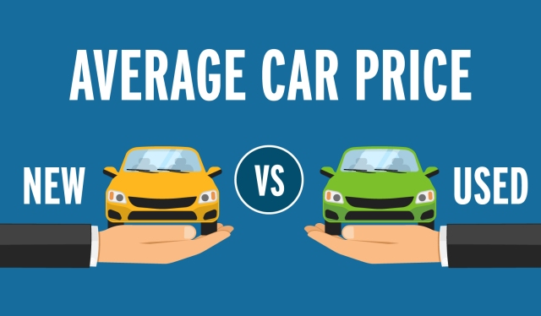
What is Used Car Price Predictions?
The increased prices of new cars and the financial incapability of the customers to buy them, Used Car sales are on a global increase. Therefore, there is an urgent need for a Used Car Price Prediction system which effectively determines the worthiness of the car using a variety of features.

Slide 7

Importance of Used Car Price Prediction
The prices of new cars in the industry is fixed by the manufacturer with some additional costs incurred by the Government in the form of taxes. So, customers buying a new car can be assured of the money they invest to be worthy. But due to the increased price of new cars and the incapability of customers to buy new cars due to the lack of funds, used cars sales are on a global increase. There is a need for a used car price prediction system to effectively determine the worthiness of the car using a variety of features. Even though there are websites that offers this service, their prediction method may not be the best. Besides, different models and systems may contribute on predicting power for a used car’s actual market value. It is important to know their actual market value while both buying and selling.

Slide 8
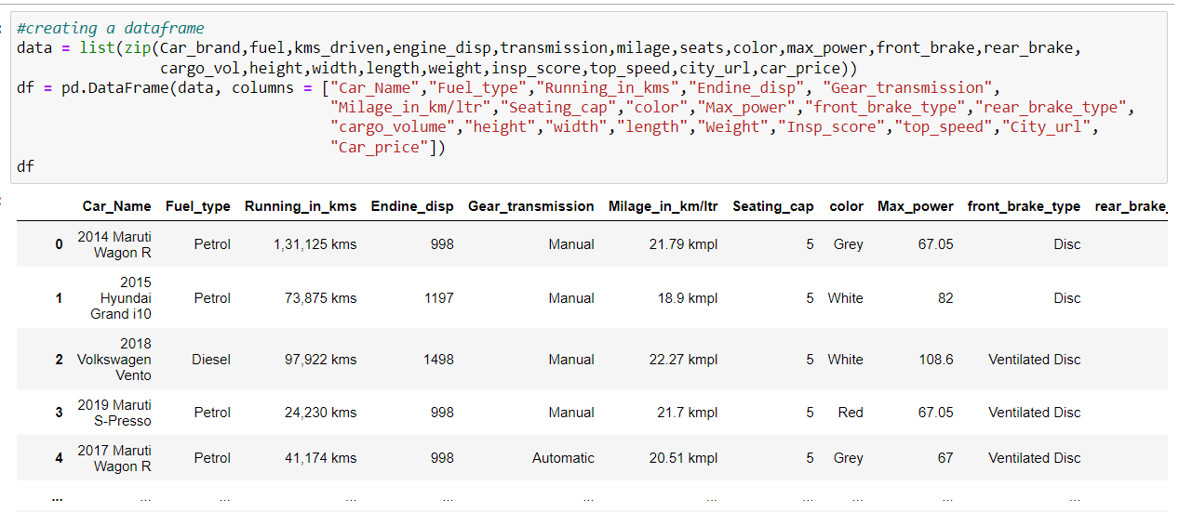
Data Loading and Description of Data
I have collected used cars data from cars Dekho site
I have imported required libraries and I have imported the dataset which was in excel format.
First I have scraped the url of each car then from that url I have scraped other data like Car name, city, fuel, car_price, mileage, kms driven
Using selenium and Beautiful Soup, I have scraped details of cars.
I have created blank list of all details required and using selenium and Beautiful Soup

Slide 9
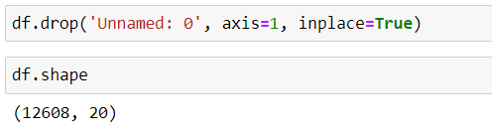
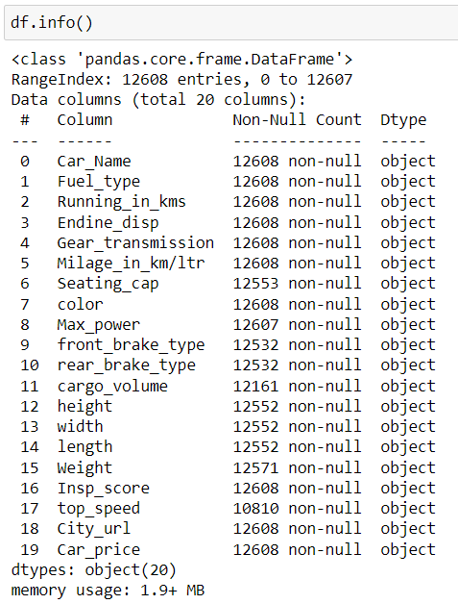
Exploratory Data Analysis
After importing and loading the dataset I have checked the shape of data and removed Unnamed Column as it was just giving index. Shape of data is 12608 rows and 20 columns
Using df.info(), I have checked information about a DataFrame including the index dtype and columns, non-null values and memory usage.

Slide 10
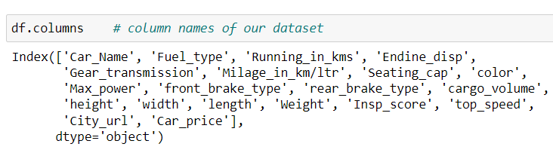

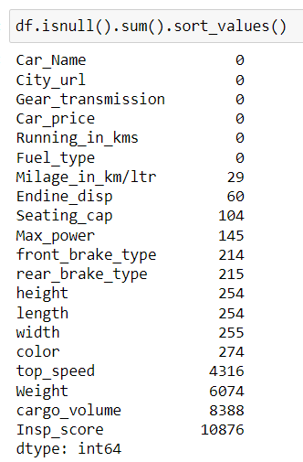

Using df.columns checked the names of all columns
Checking null values of dataset by isnull() method
I have replaced blank and hyphen columns with nan values to get the total and proper count of missing values
Also removed the columns where missing values were greater than half of its total count
Then shape of the data was changed to 12608 rows and 18 columns after removing ‘cargo_volume’ and ‘Insp_score’

Slide 11
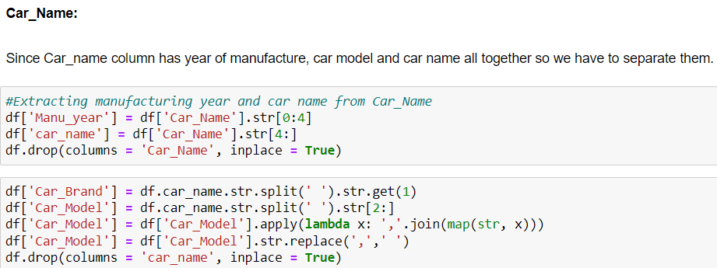
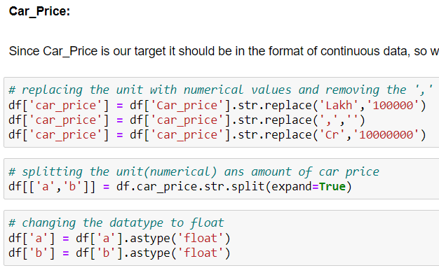
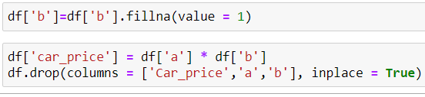
Also performed feature extraction on some columns.
Screen shots attached for reference
From car_name I have extracted the manufacturing year, brand name and car model.
From Car_price first I replaced the units with numerical values
Then separated the unit and amount value and checked for missing values in unit column and replaced those values with 1
Then multiplied both separated values and unit values

Slide 12
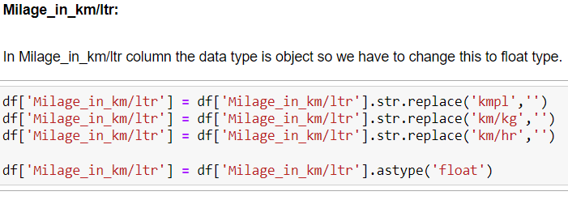
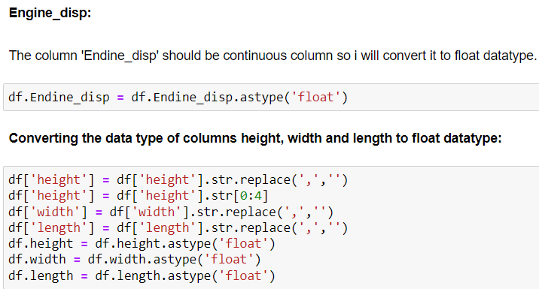
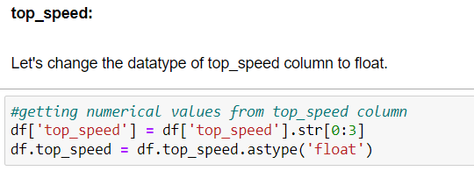
Similarly, I have extracted some meaningful data from columns like Milage_in_kms/ltr, Engine_disp, top_speed
Also changed their datatype from object to float.
Screen shots are attached for reference.
Extracted city name from urls
Separated units and values in columns like milage_in_kms/ltr, top_speed, etc
Also replaced similar values under one head in all columns.
Screen shot of all the above steps are attached in next two slides.

Slide 13
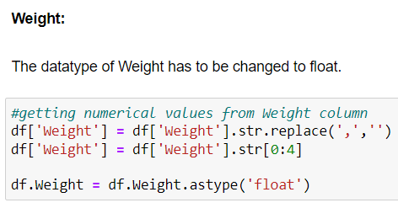
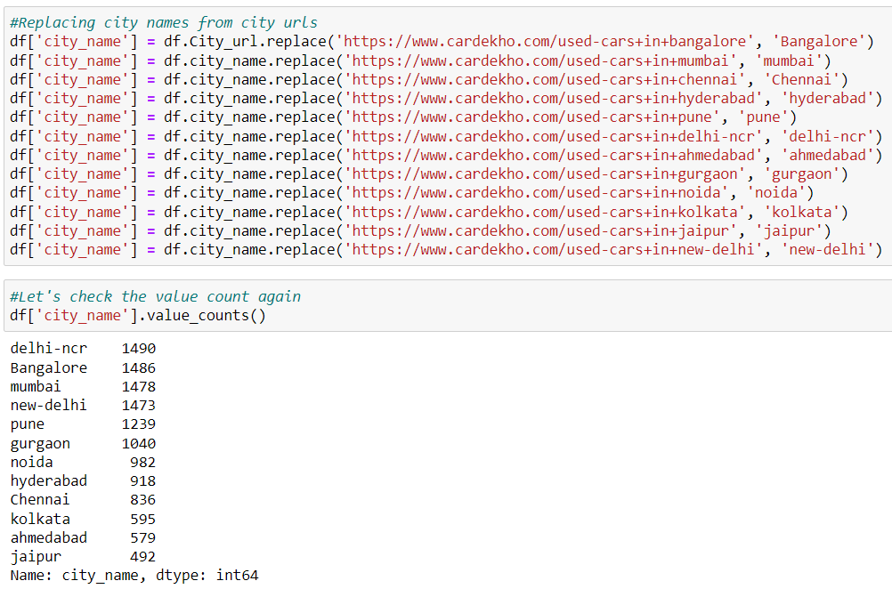
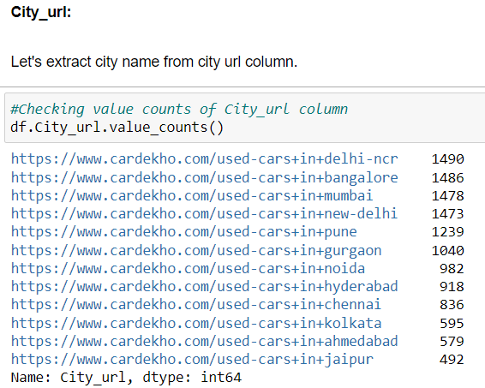

Slide 14
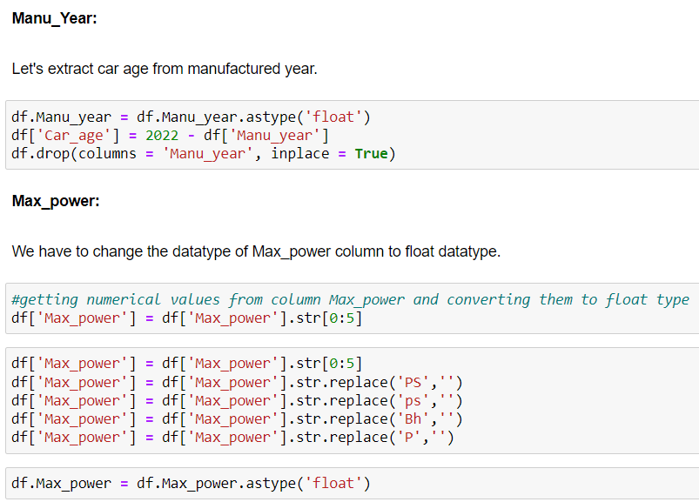
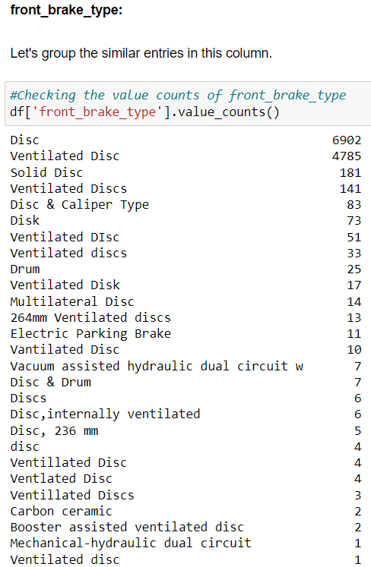
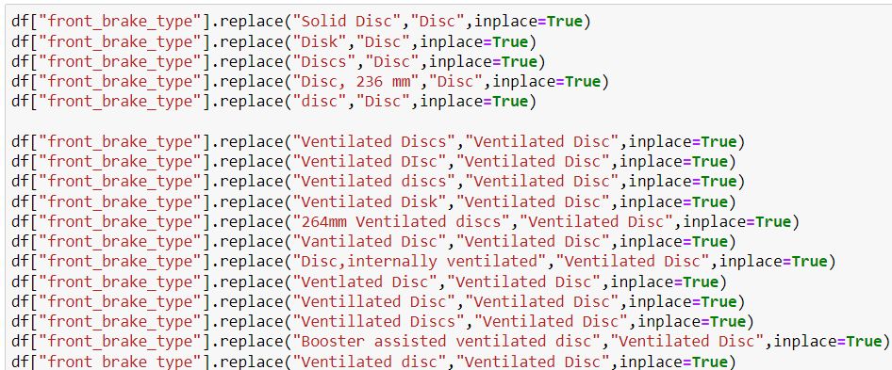

Slide 15
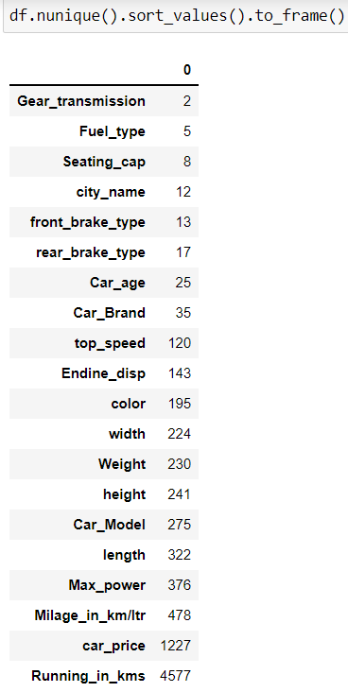
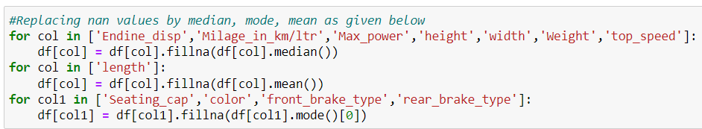
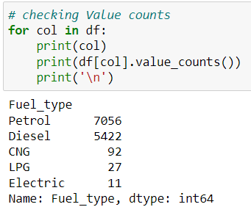
Handling Missing Values
Replaced numerical columns missing values with median and mean and categorical columns are replaced with mode.
Checking Unique Values and Value Counts
After replacing, cleaning and combining similar values under one head I have got the unique values and value counts
Screen shots are attached in this slide

Slide 16
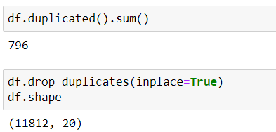
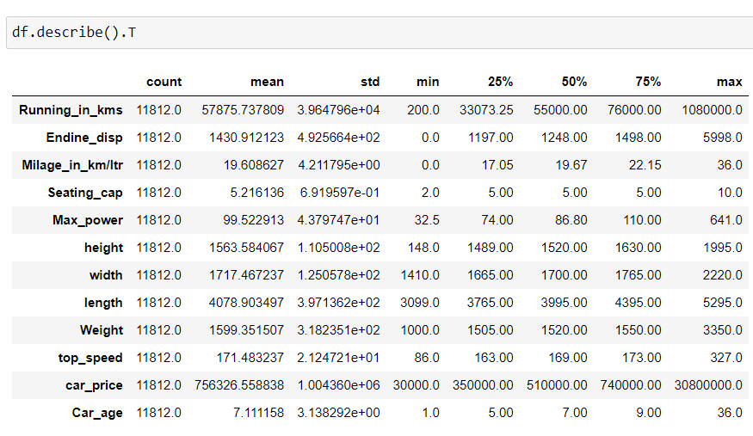
Checking Duplicate Values and Statistical Analysis
I have found 796 duplicate values and drop the them. And shape of data is changed to 11812 rows and 20 columns
I have used describe method for statistical analysis and found following observations
All columns has same count ie. 11812.
columns are: Running_in_kms, Endine_disp, Seating_cap, Max_power, height,width,Milage_in_km/ltr length, Weight, top_speed,car_price,Car_age. All these columns are right skewed.
Larger difference between 75% and Max value indicates presence of outliers.

Slide 17
Visualizations
Univariate Analysis

Slide 18
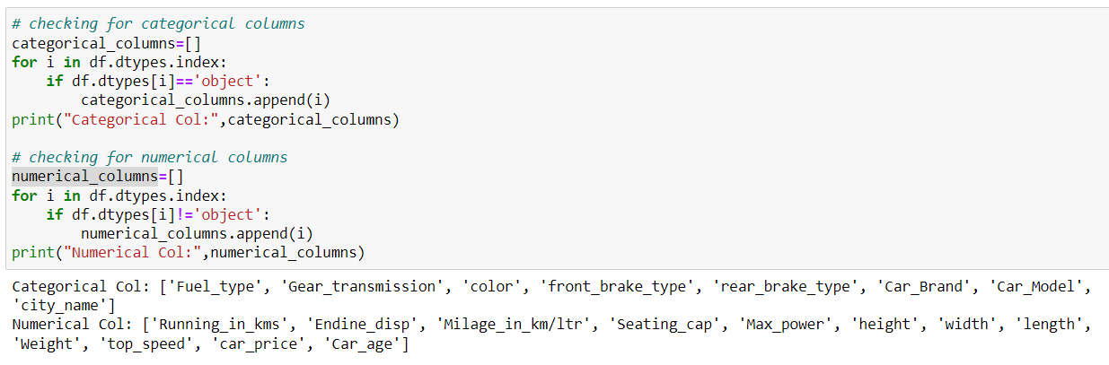
Observations
Univariate analysis of categorical columns was done after separating the columns. Screenshot of code is attached. Following observations were made
Maximum cars are petrol driven and also diesel driven.
Maximum cars are with Manual gear transmission.
Disc front brake cars are more in number followed by Ventilated Disc.
Drum rare break cars are more in number.
Maximum cars under sale are Maruti followed by Hyundai.
In Bangalore, Delhi-NCR, Mumbai and New Delhi we can find maximum cars for sale. Since these are most populated places.

Slide 19
Univariate analysis of continues variable

Slide 20
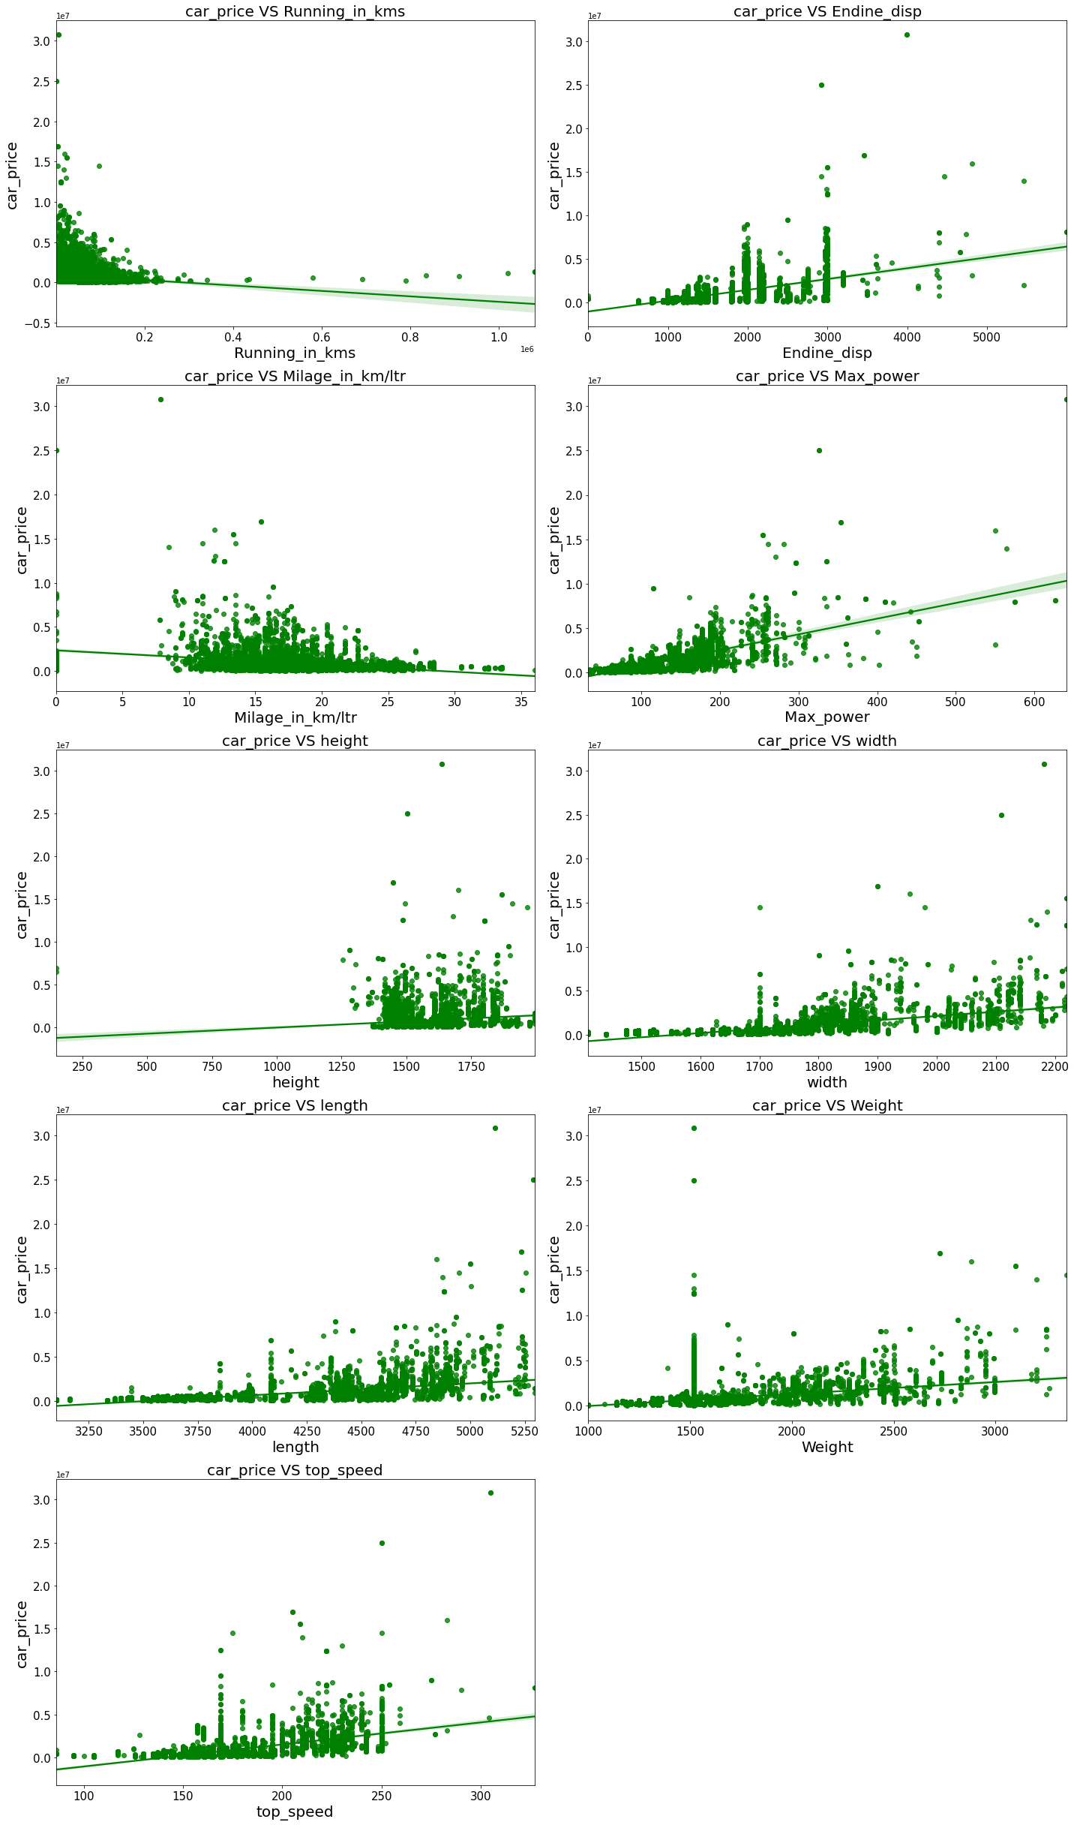
Bivariate Analysis
Comparing car price and columns in list of col.

Slide 22
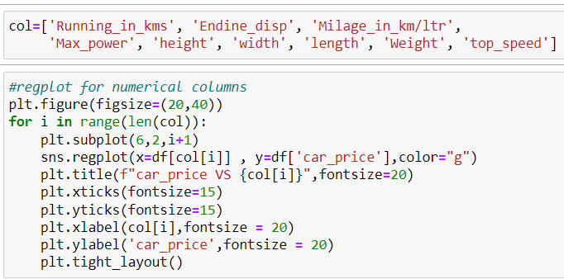
Comparing car price and columns in list of col.
Observation:
Maximum cars are having below 20k driven kms. And car price is high for less driven cars.
Maximum cars are having 1000-3000 Endine_disp. And car price is high for 3000 Endine_disp. Maximum cars are having milage of 10-25kms. And ,milage has no proper relation with car price.
As Max_power is increasing car price is also increasing.
Car_price has no proper relation with height.
As the width is increasing car price is also increasing.
As length is increasing car price is also increasing.
Weight also has linear relationship with car price.
As top_speed is increasing car price is also increasing.

Slide 23
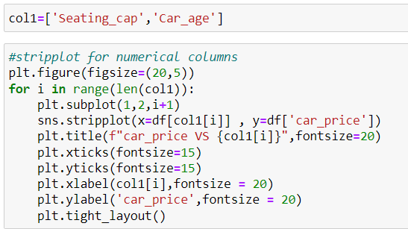
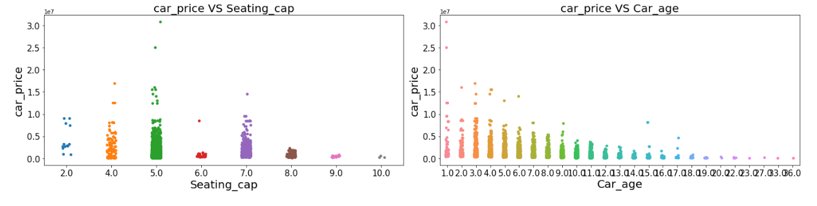
Comparing car price and columns in list col1
Observations
Cars with 5 and 4 seats are having highest price.
As the age of the car increases the car price decreases.

Slide 24
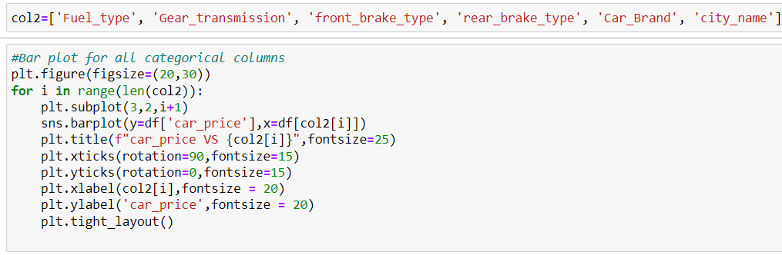
Comparing car price and columns in list col2
Observations:
For Diesel and Electric cars the price is high compared to Petrol,LPG and CNG.
Cars with automatic gear are costlier than manual gear cars.
Cars with Carbon Ceramic front break are costlier compared to other cars.
Lamborghini brand cars are having highset sale price.
In Bangalore, Hyderabad and delhi-ncr the car prices are high as they are highly populated cities.

Slide 25
Comparing car price and columns in list col2

Slide 26
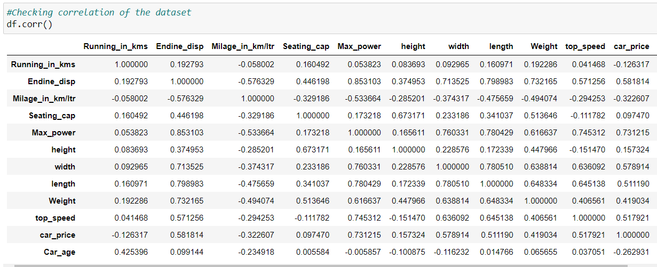
Checking Correlation

Slide 27
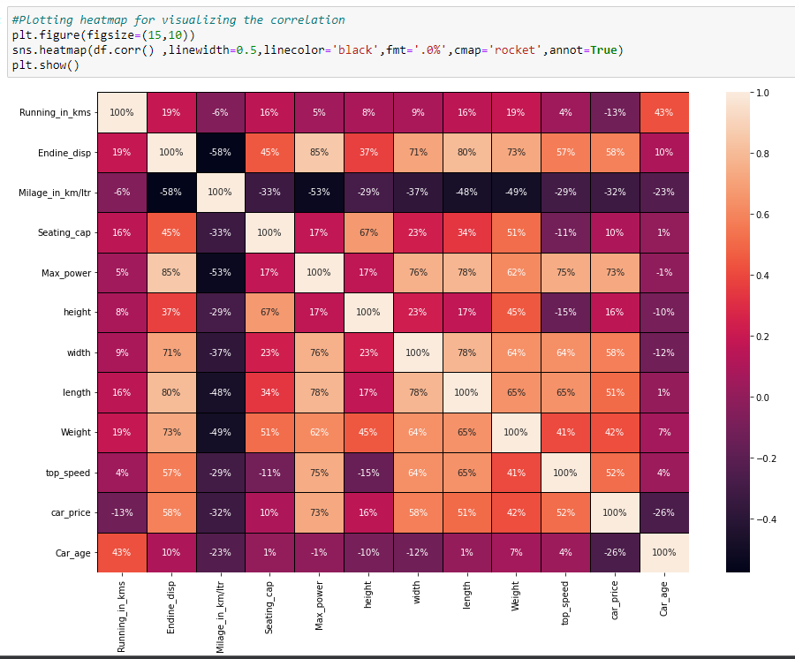
Graphically plotting the correlation
Observations:
Highly and positively correlated: Max_power, width, Endine_disp, top_speed, weight, length
Negatively and least correlated: Running_in_kms, Car_age

Slide 28
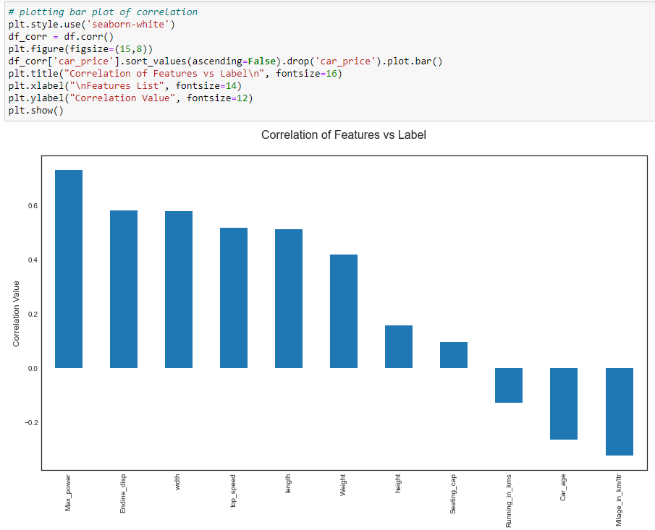
Graphically plotting the correlation using bar plot
we can see from above graph that max_power has highest correlation with car_price followed by, endine-disp and least correlation is with Seating_cap

Slide 29
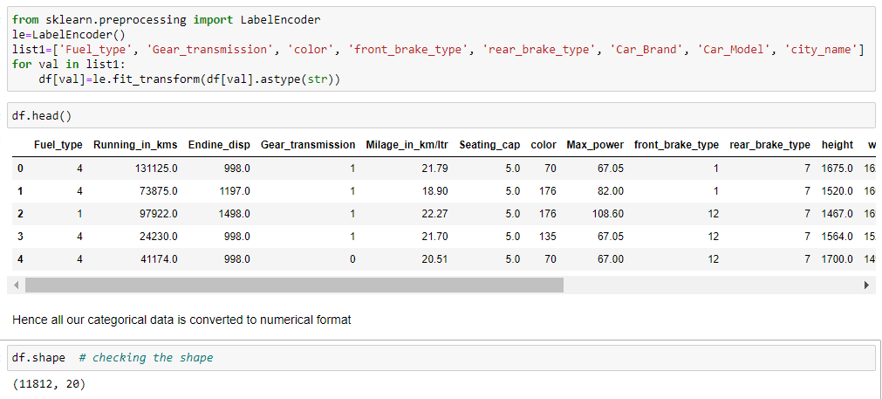
Encoding the Categorical data
Using Label Encoder I have transformed all categorical data into numerical form and checked the shape of data
screen shot is attached below

Slide 30
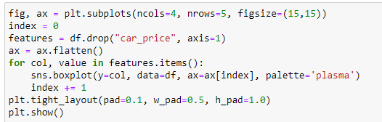
Checking Outliers
From above box plots we can see that columns having outliers are: Running_in_kms, Endine_disp, Milage_in_km/ltr, Seating_cap, height, width, weight, top_speed, car_age. I have not considered encoded columns for outliers

Slide 31
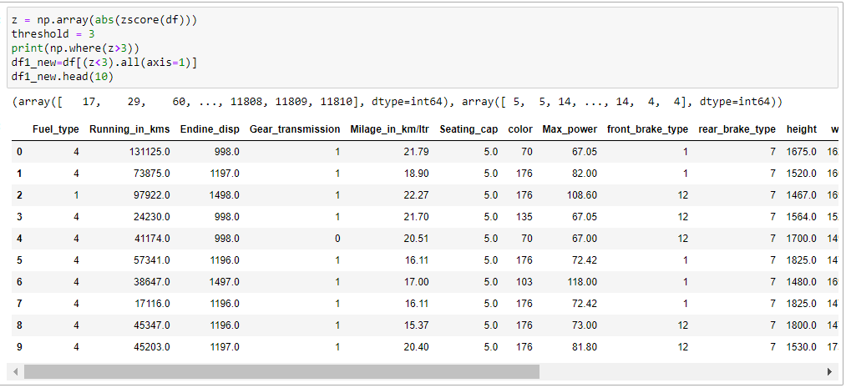
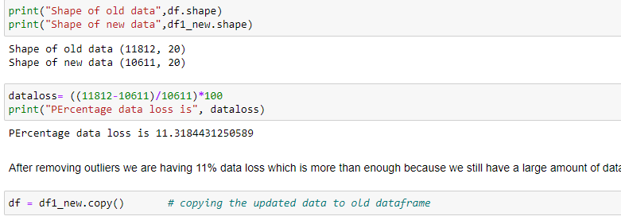
Removing Outliers
I have removed outliers using zscore method.
Treshhold value is 3
Data loss in this process is 11%
But as the data is large we can afford this loss
New shape of data is 10611 rows and 20 rows

Slide 32
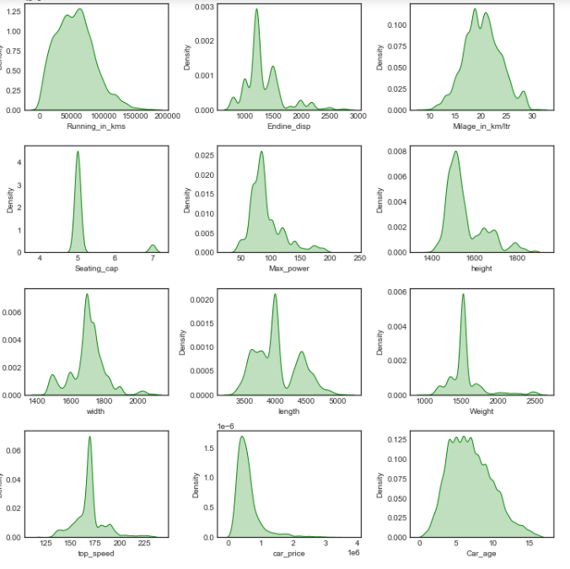
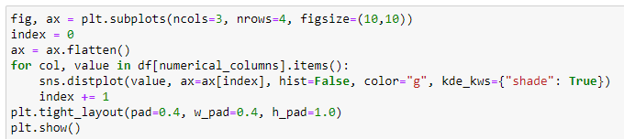
Checking Skewness
Observations
We see from above plots that skewness is present in some columns which are:height, Endine_disp, top_speed, Max_power, Weight, seating_cap again I am ignoring the encoded coluumns as there is no point in treating their skewness

Slide 33

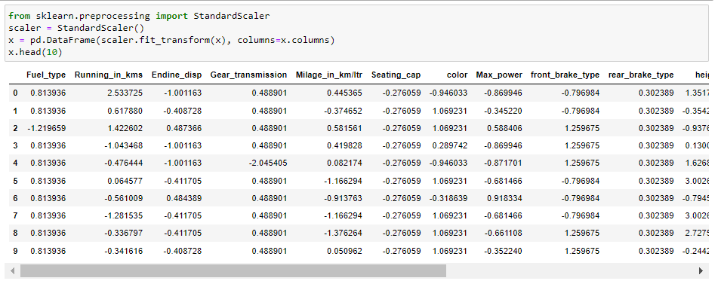
Splitting the dataframe in Feature and target Variable
Observations
I have splitted the data in target variable and feature variable.
X denoting feature varible and Y denoting the target variable
Standardization of Data
Observations
Using standard scaler I have scaled the feature variables. This is called Standardization of data

Slide 34
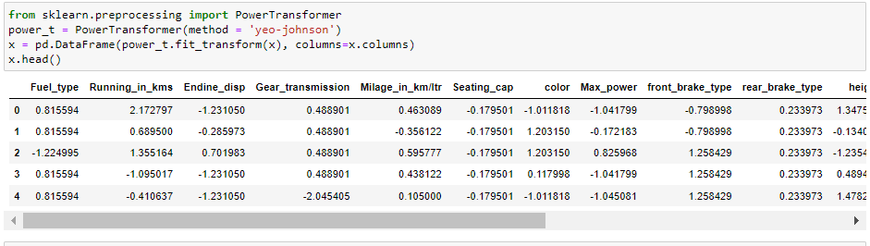
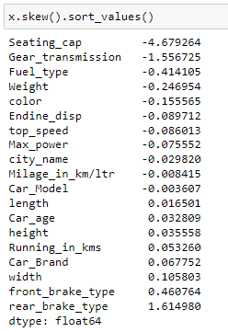
Removing Skewness
Observations
Hence here we have tried removing skewness using power transformation.
Ignoring the skewness of encoded variables

Slide 35
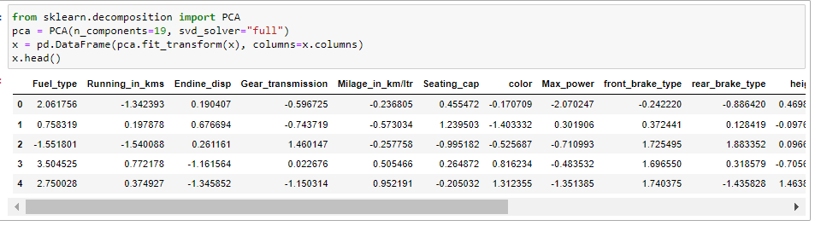
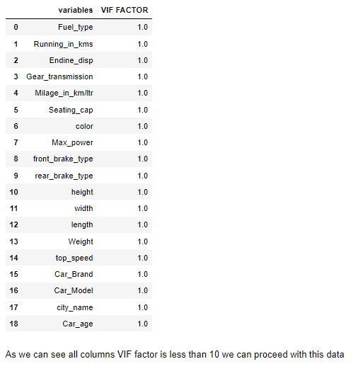
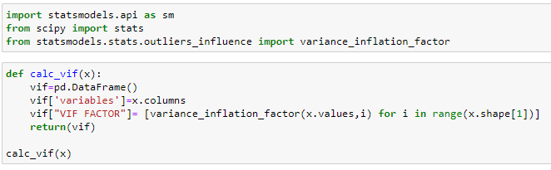
Principle Component Analysis
Checking Multicollinearity

Slide 36
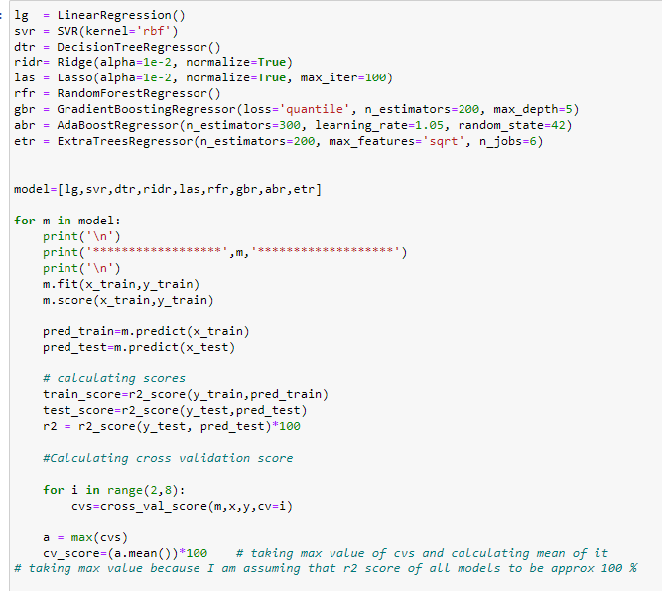
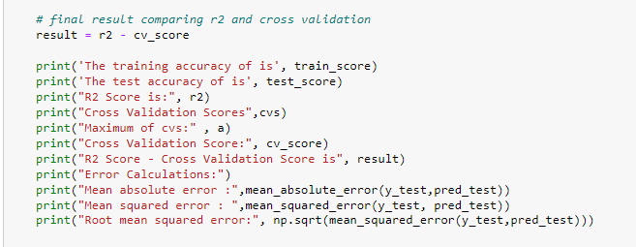
Model/s Development and Evaluation
I have created a loop where all model are fitted in and tested
Also I have created a loop for every model to go under cross validation
Results of each model is shared in next slide

Slide 37
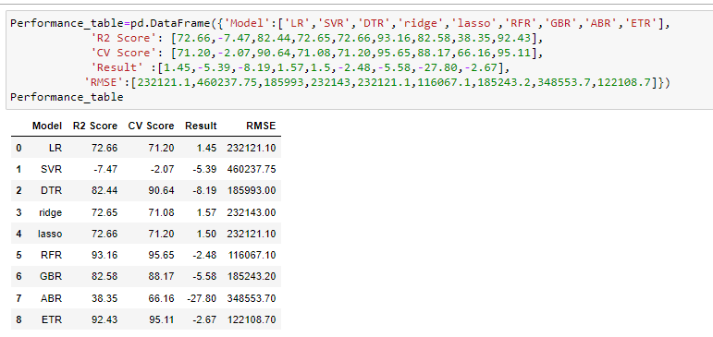
Model/s Development and Evaluation
Observations
All results are stored in a table format for easy view.
From that I found that Random Forest Regressor gives the best results

Slide 38
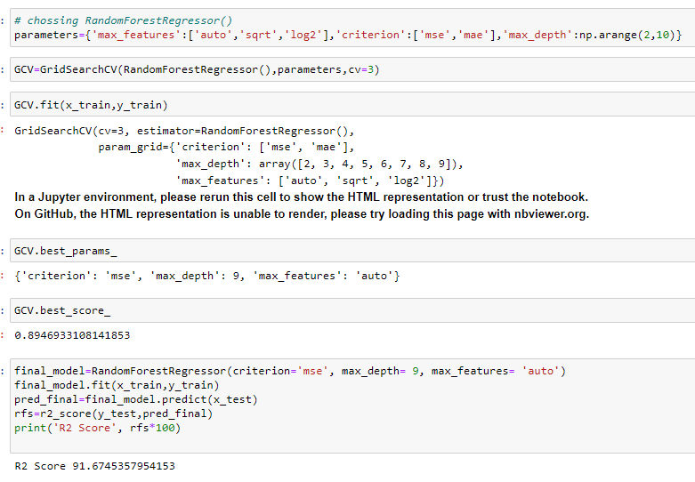
Hypertuning
Using Grid Search CV I have used hypertuning to increase the accuracy
Of selected model
And chose the hypertuned parameters are given in screen shot and got the final R2 score as 92%

Slide 39

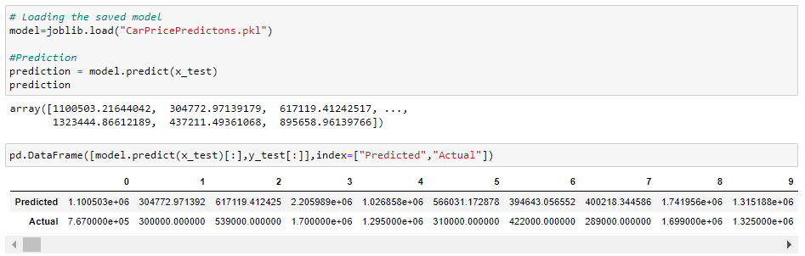
Saving the Model
Plotting the Results

Slide 40

Saved the model using joblib
After saving I have loaded the saved model to compare the actual and predicted values of target variable that is car price
Also plotted the same as shown

Slide 41
Conclusion
In this project report, we have used machine learning algorithms to predict the used car price. We have mentioned the step by step procedure to analyse the dataset and finding the correlation between the features.
Thus we can select the features which are correlated to each other and are independent in nature. The power of visualization has helped us in understanding the data by graphical representation it has made me to understand what data is trying to say.
Data cleaning is one of the most important steps to remove unrealistic values and unnecessary values.
These feature set were then given as an input to five algorithms and a hyper parameter tunning was done to the best model and the accuracy has been improved. Hence we calculated the performance of each model using different performance metrics and compared them based on these metrics.
Then we have also saved the best model and predicted the car price. It was good that the predicted and actual values were almost same.
To conclude, the application of machine learning in car price prediction is still at an early stage. We hope this study has moved a small step ahead in providing some methodological and empirical contributions to online platforms, and presenting an alternative approach to the valuation of used car price.
Future direction of research may consider incorporating additional used car data from a larger economical background with more features.

Slide 42
thank you
Purva Sonsare

